Slide 1
Handwritten English & Chinese Recognition
Group 14
韩嘉祺 陈醉 安丽华

Slide 2
To be covered
English Recognition
Pipeline
Preprocessing
Segment lines & words
Recognition Algorithm
Results
Chinese Recognition
Pipeline
Results
Workload distribution

Slide 3
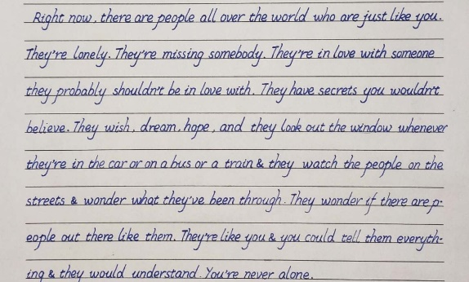
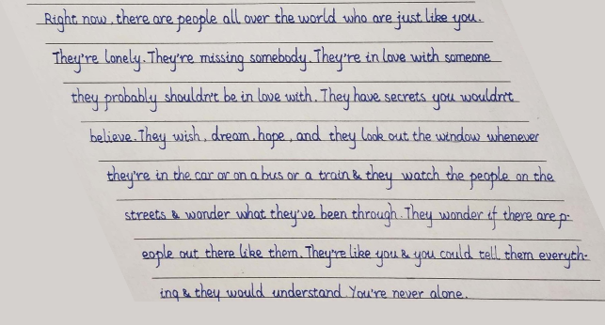
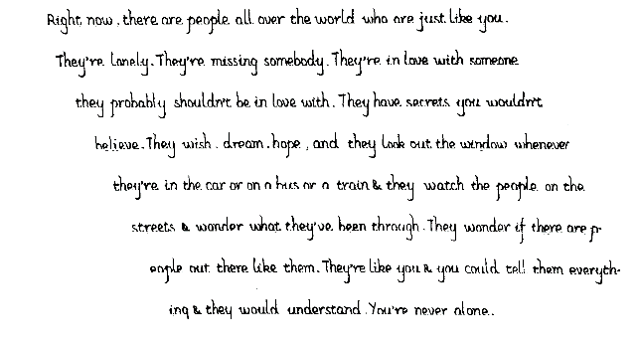
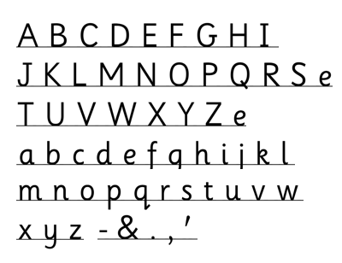
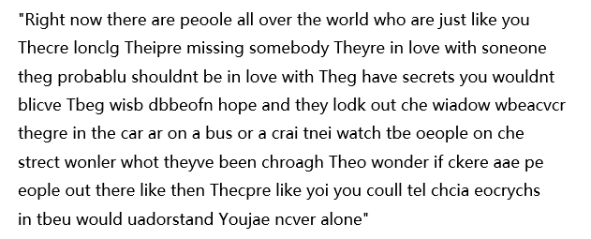
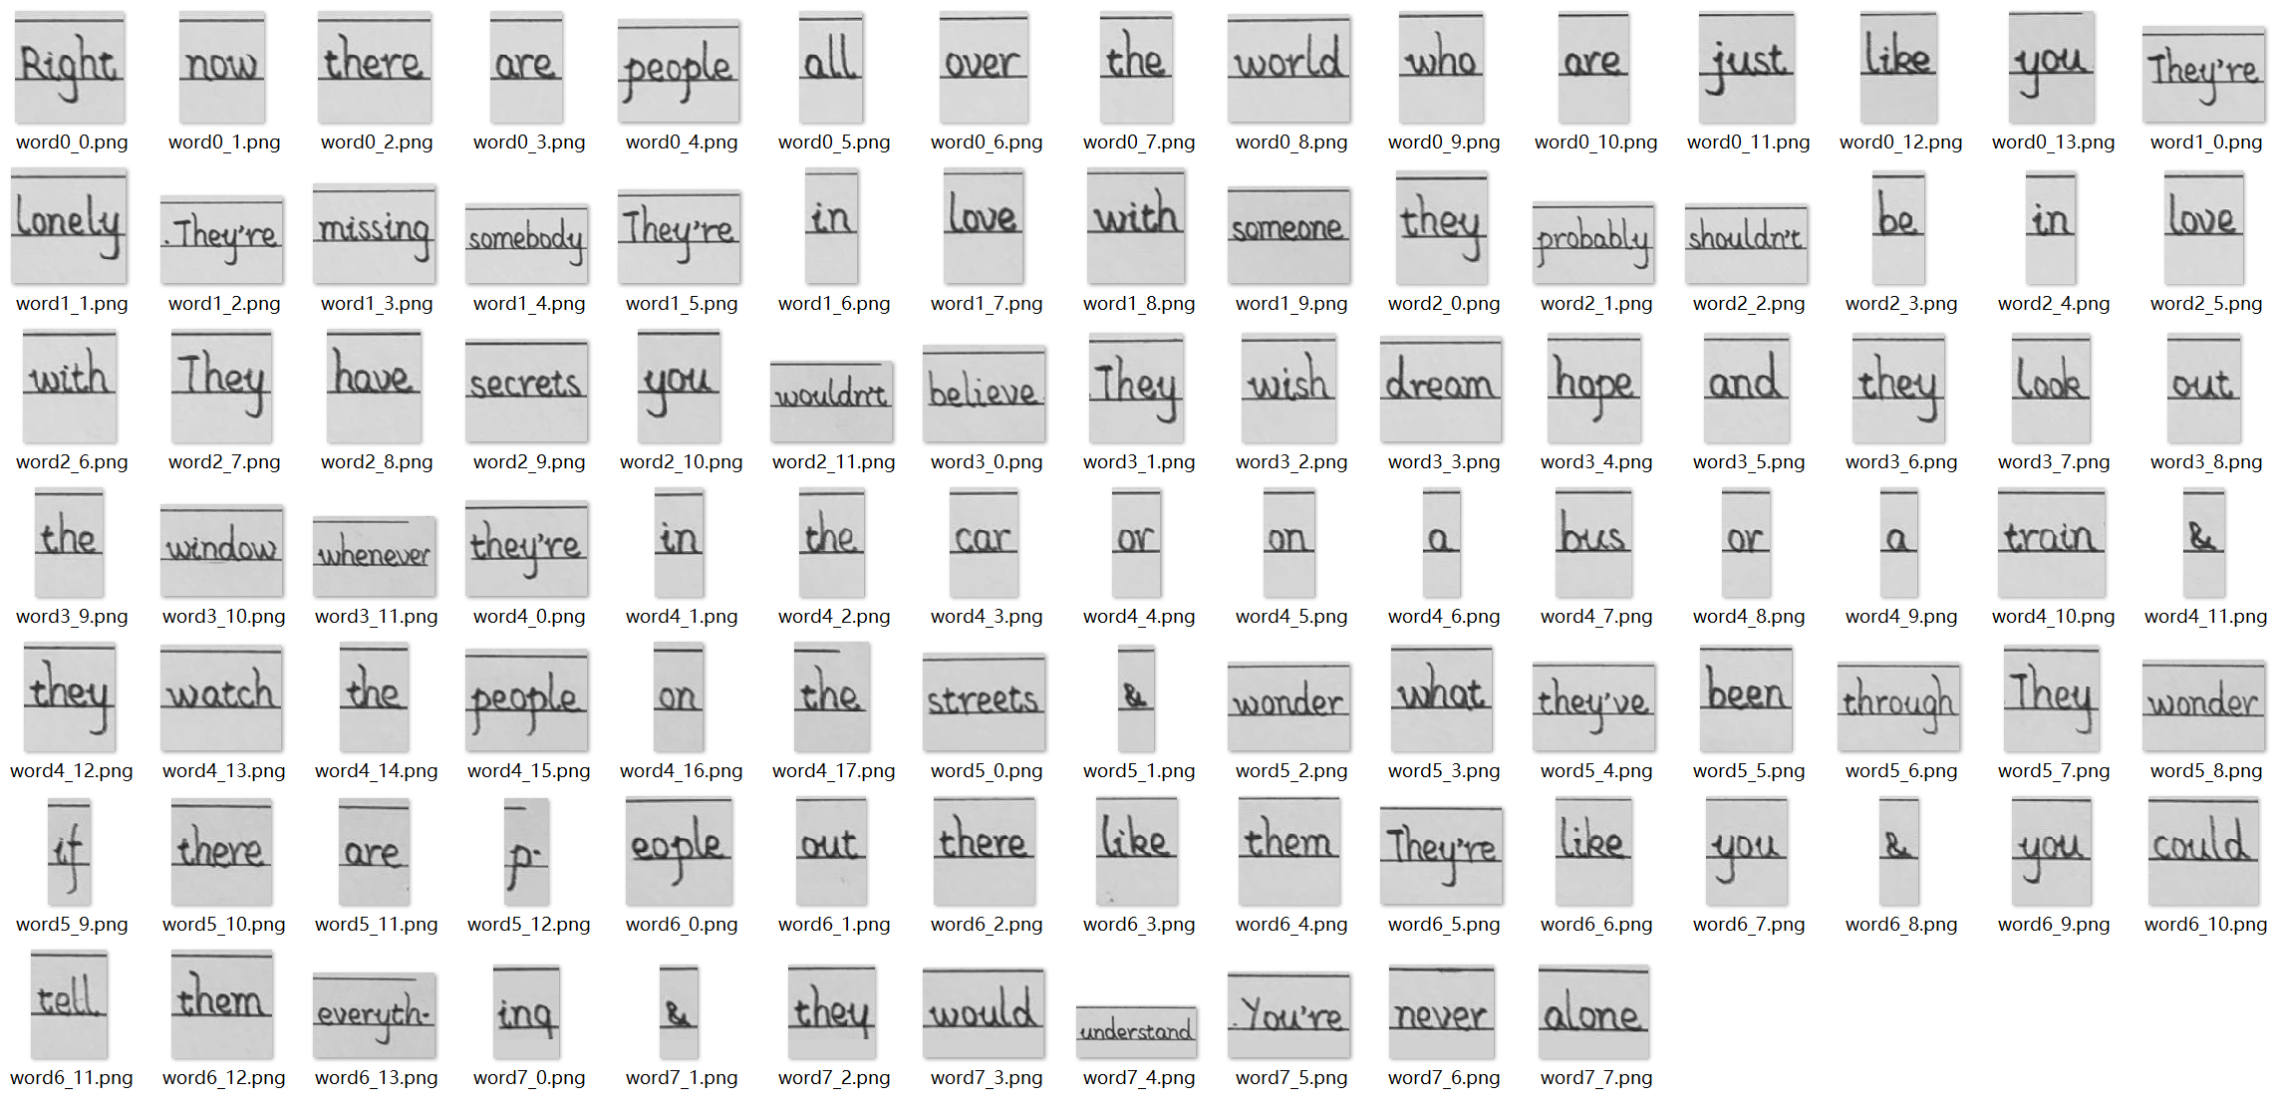
English: Pipeline
Skew
Correction
Underline
Removal
Segment lines & words
Template Matching based Algorithm

Slide 4
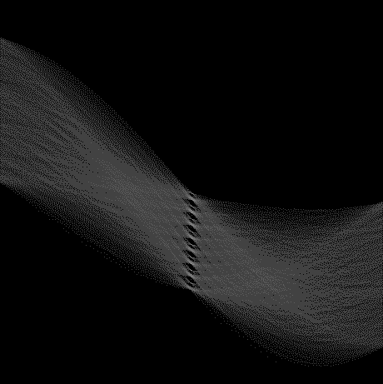
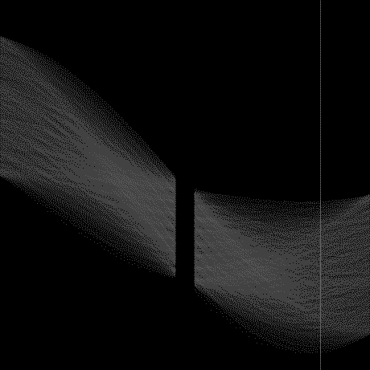
English: Preprocessing
Skew correction
Characters are all inclined at a fixed angle
Use the Hough transform to find the angle
Use affine shear to correct the image
Underline removal & denoising
Use morphological opening to remove underlines
Limited repairs made based on the continuity of vertical lines.
argmax = 65.97°

Slide 5

English: Preprocessing
Notes:
可以看见，下划线，连带着上面的笔迹都被移除了，此外对竖线进行了有限的修复

Slide 6
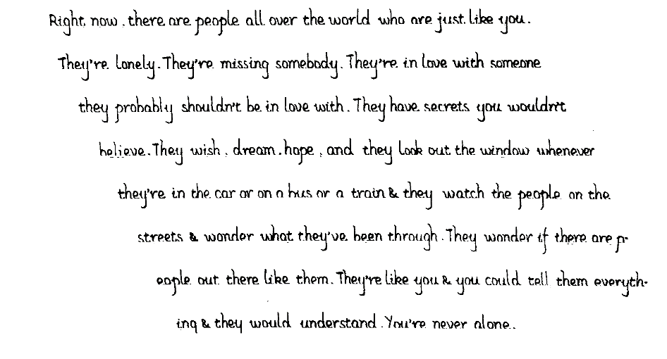
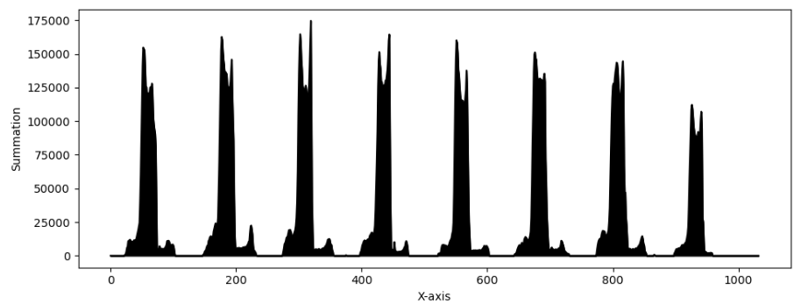
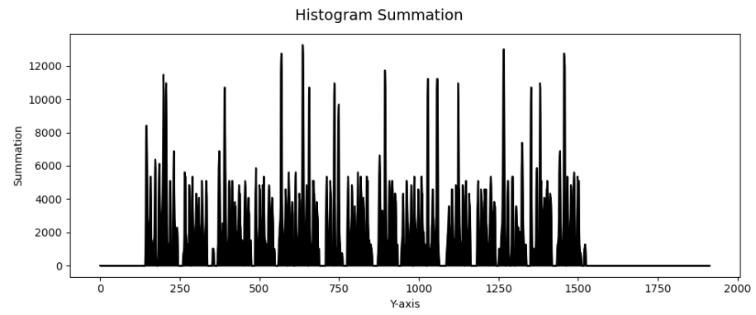
English: Segment lines & words
Projection based algorithm
Projection on x-axis, segment lines
Projection on y-axis, segment words
Set thresholds for space & word length
Result
Segment lines 100% accurate
Segment words 100% accurate
Segment characters not possible
Notes:
分字母的情况很复杂，每个词宽度不等，w被分成vv，m被分成rn，d被分成cl，ou粘连等，哪怕是OCR手写识别的SOTA算法也无法在不识别的情况下做好分割

Slide 7
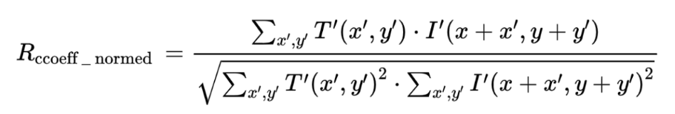
English: Recognition Algorithm
Basic idea: template matching
With limited performance, the key is to find the finest template.
Algorithm: Two-stage Template Matching
First find best matches on the image with other templates.
Then use best matches as templates to find bounding boxes.
Apply non-maximum suppression (NMS) to refine results.
Abandoned algorithms：
Thinning & Skeletonize
Key points & xy Projection
Fourier Descriptors
Notes:
没有使用基于学习的方法
这里模板匹配用的是标准相关匹配，测试下来最好的匹配方法
Thinning & Skeletonize——下划线的存在或者对下划线的移除都导致骨骼不能正常提取，导致的问题比较多
Key points & xy Projection——效果很糟糕
Fourier Descriptors——得针对单个字符，但是我们做不到单个字符分割

Slide 8
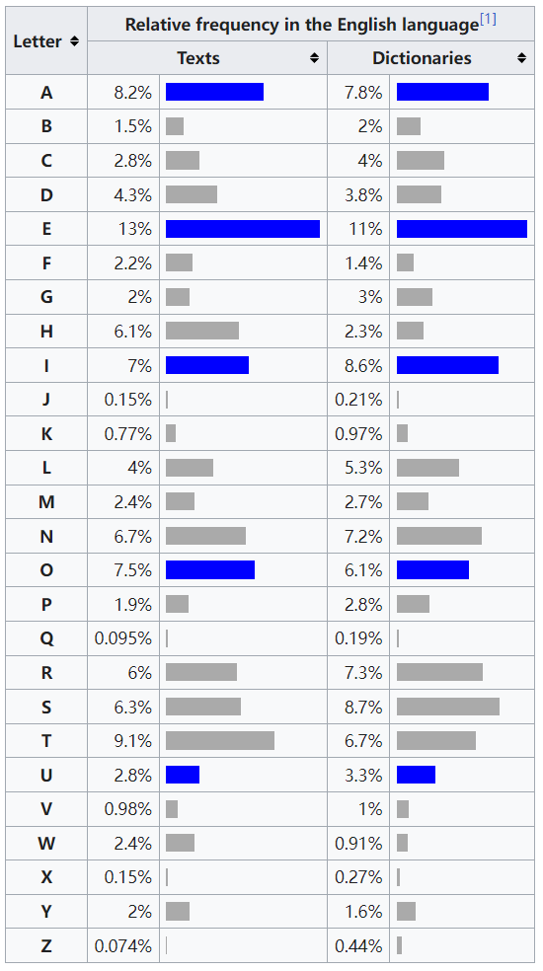
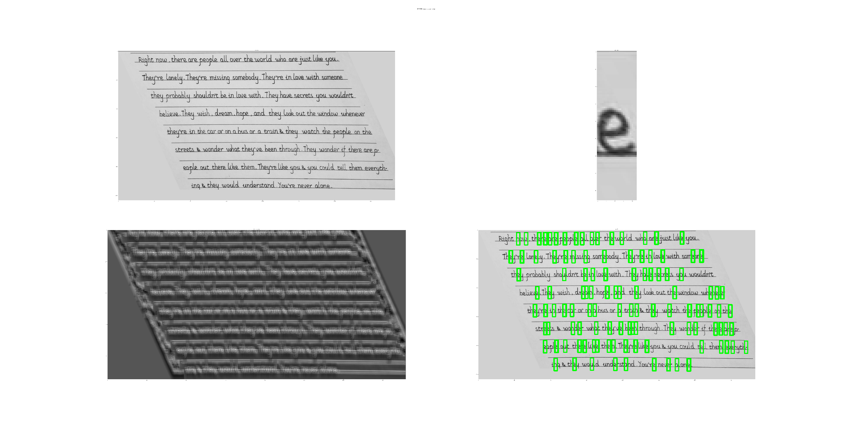
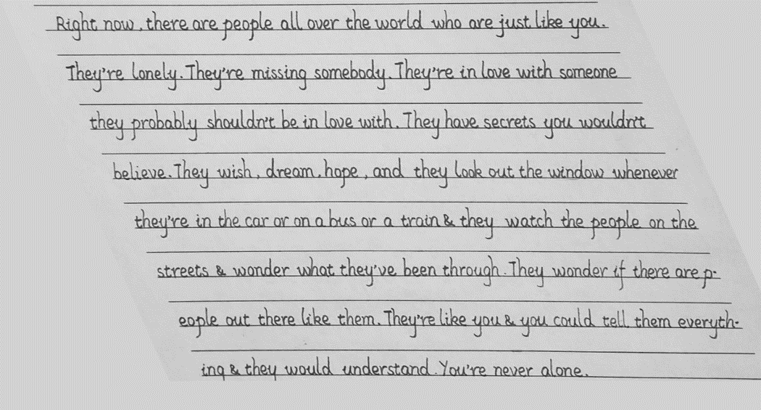
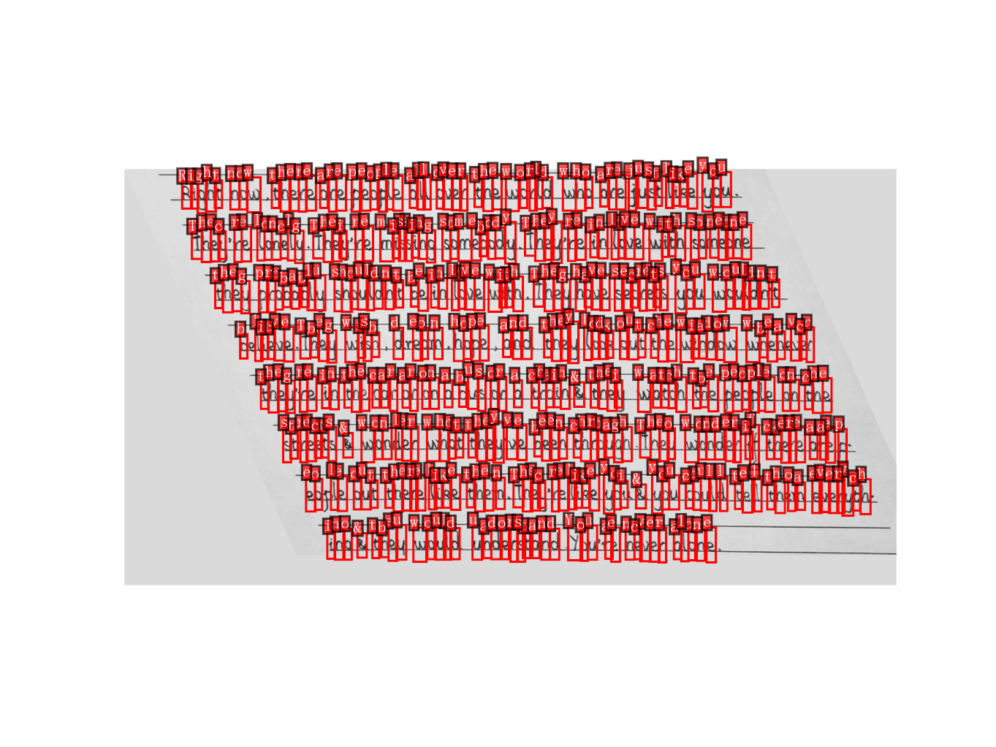
English: Recognition Algorithm
…
Printed Font
with underline
Best Match
Template
Matching
#1
Template
Matching
#2
NMS
Notes:
最初的模板字体是Sassoon Infant，带或不带下划线
第一步模板匹配要确保匹配到正确字母，不过这一步的准确率在校正尺寸后就很高
第二步模板匹配取的候选框数量是基于英文中各字母的出现频率来设定的
值得注意的是，这个方法的泛化性不是很好，因为如果一个字符没有出现在被识别图像中，第一步模板匹配就会出问题
设计目的就是最大化匹配的准确率，而不是泛化性；而且不适合用高深的算法

Slide 9
English: Results
people → peoole
Theyre → Thecre
lonely → lonclg
Theyre → Theipre
someone → soneone
they → theg
probably → probablu
They → Theg
believe → blicve
They → Tbeg
wish → wisb
dream → dbbeofn
look → lodk
the → che
window → wiadow
whenever → wbeacvcr
theyre → thegre
or → ar
train → crai
they → tnei
the → tbe
people → oeople
the → che
streets → strect
wonder → wonler
what → whot
through → chroagh
They → Theo
there → ckere
are → aae
p → pe
them → then
Theyre → Thecpre
you → yoi
could → coull
tell → tel
them → chcia
everyth → eocrychs
ing → in
they → tbeu
understand → uadorstand
Youre → Youjae
never → ncver
Ground Truth:
"Right now there are people all over the world who are just like you
Theyre lonely Theyre missing somebody Theyre in love with someone
they probably shouldnt be in love with They have secrets you wouldnt
believe They wish dream hope and they look out the window whenever
theyre in the car or on a bus or a train they watch the people on the
streets wonder what theyve been through They wonder if there are p
eople out there like them Theyre like you you could tell them everyth
ing they would understand Youre never alone"
Recognized:
"Right now there are peoole all over the world who are just like you Thecre lonclg Theipre missing somebody Theyre in love with soneone theg probablu shouldnt be in love with Theg have secrets you wouldnt blicve Tbeg wisb dbbeofn hope and they lodk out che wiadow wbeacvcr thegre in the car ar on a bus or a crai tnei watch tbe oeople on che strect wonler whot theyve been chroagh Theo wonder if ckere aae pe eople out there like then Thecpre like yoi you coull tel chcia eocrychs in tbeu would uadorstand Youjae ncver alone"
Notes:
很多一个识别成两个的和两个识别成一个的

Slide 10
English: Results
Evaluation
Edit Distance (ED)，Ground Truth (GT)
Character Error Rate
CER = ED(predicted, GT) / length(GT), character as basic element
Word Error Rate，word as basic element
WER = ED(predicted, GT) / length(GT), word as basic element
Word level accuracy
WACC = correct words / all words
Notes:
如果两个序列的长度不同，计算准确率是不可能的
所以我们采用OCR中的一些常用指标
编辑距离 (莱文斯坦距离，Levenshtein Distance) ，是一个序列经过多少次单元的增删改后能变到另一个序列

Slide 11
English: Results
Template & Image | CER ↓ | WER ↓ | WACC ↑
with underline | 0.133 | 0.443 | 55.67%
without underline | 0.252 | 0.701 | 22.68%

Slide 12
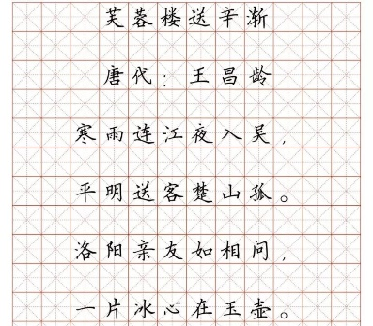
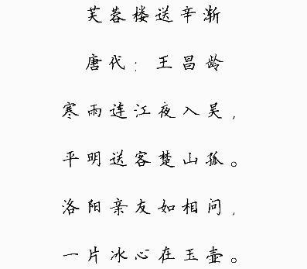
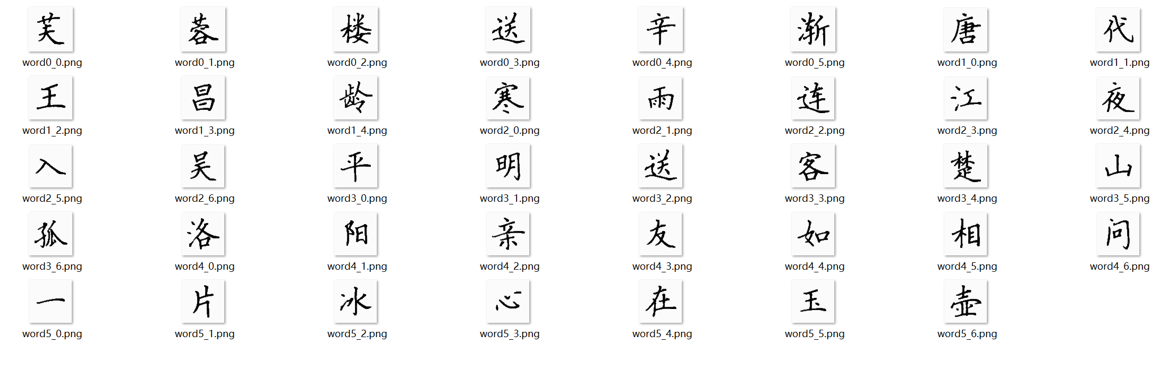
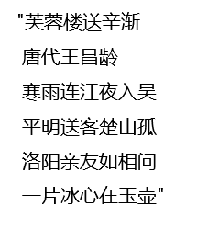
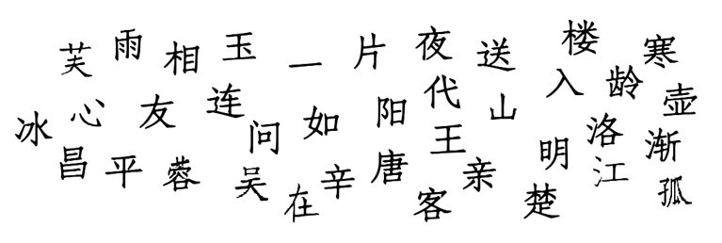
Chinese: Pipeline
Chinese recognition is mostly a subset of English recognition
Denoise
Segment
Template Match
Notes:
处理方法上区别在于去背景使用了HSV颜色域提取黑色，以及不需要倾斜纠正

Slide 13



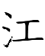
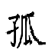

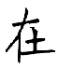


Chinese: Results
Ground Truth:
"芙蓉楼送辛渐 唐代王昌龄 寒雨连江夜入吴 平明送客楚山孤 洛阳亲友如相问 一片冰心在玉壶"
Recognized (best):
"芙蓉楼送辛渐 唐代王昌龄 寒雨连江夜入吴 平明送客楚山孤 洛阳亲友如相问 一片冰心在玉壶"
Modify script using Microsoft Paint
Template | ACC ↑
Regular script | 82.1%
Modified script | 100%
Notes:
原始模板是正楷
不经过人工微调有7/39个字符识别错误

Slide 14
Workload distribution
韩嘉祺：
Recognition algorithm, Code integration
Presentation
Report
陈醉：
Segment lines & words
Report
安丽华
Preprocessing
Realize cv2 built in functions
Report

Slide 15
谢谢！

